Slide 1

Intership Project report
Name : Arshit Kumar Domain: Web Development (Frontend)

Slide 2
Project 1: Countdown app

Slide 3
Problem statement
Primary Issue: Lack of user-friendly and visually appealing countdown tools.
Challenges in Existing Solutions:
Overwhelming features for simple tasks.
Poor UI/UX in many apps.
Non-responsive design for mobile users.
Need: A reliable countdown timer is crucial for personal and professional time management.

Slide 4
Project Objective
Primary Goals:
Deliver an easy-to-use web-based countdown timer.
Ensure cross-platform accessibility.
Add engaging visuals to enhance user experience.
Key Focus Areas:
Usability: Simple controls for everyone.
Performance: Real-time updates with no lag.
Customization: Personalized countdowns for any event.

Slide 5
Techniques Used (Frontend)
HTML:
Structured input forms for date, time, and event name.
Used semantic elements for accessibility.
CSS:
Created a responsive grid layout.
Applied animations for a dynamic countdown effect.
Used media queries to adapt the design for all screen sizes.
JavaScript:
Utilized setInterval() for real-time updates.Validated user inputs (e.g., past dates, empty fields).
Dynamically updated the DOM with the remaining time.

Slide 6
Features
Countdown Timer:
Set a countdown for any specific date or time.
Real-time updates that display remaining time in days, hours, minutes, and seconds.
Event Customization:
Users can name events (e.g., “Project Deadline”, “Birthday”).
Alerts :
Visual alert when the countdown reaches zero.
Responsive Design:
Optimized for desktops, tablets, and mobile devices.Fluid layout that adjusts for any screen size.

Slide 7
Challenges Solved
Real-Time Functionality:
Ensured consistent time updates without freezing.
Input Validation:
Prevented invalid or blank inputs to maintain functionality.
Cross-Browser Compatibility:
Tested across Chrome, Firefox, and Edge to ensure seamless performance.
UI Responsiveness:
Achieved a fluid design that adapts to all devices.

Slide 8
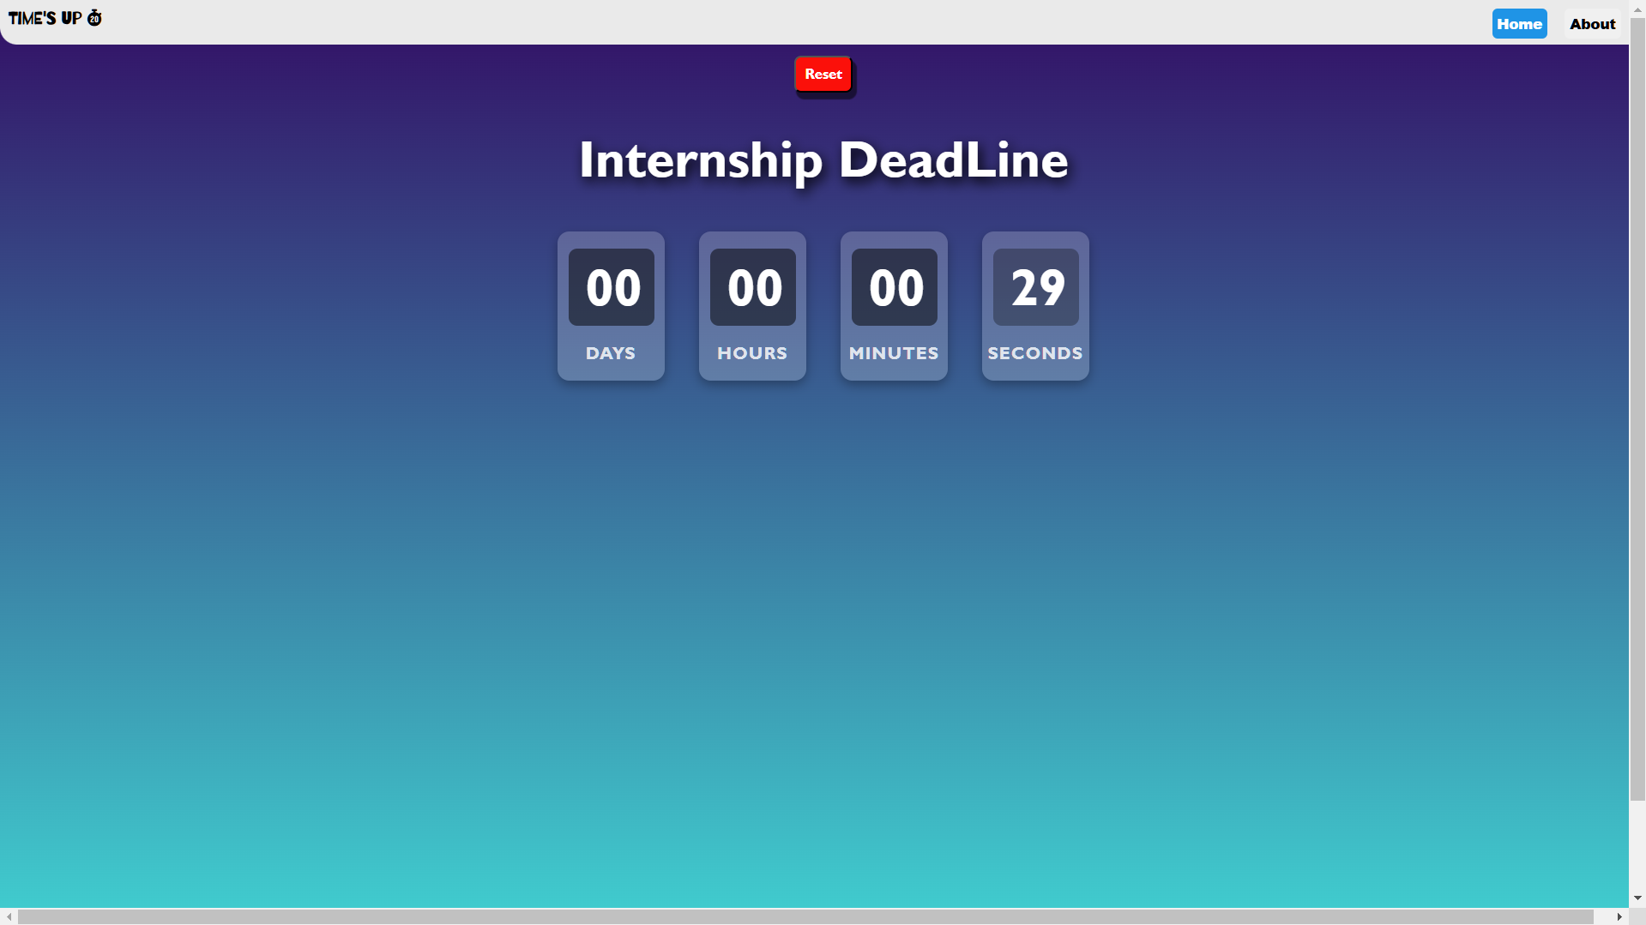
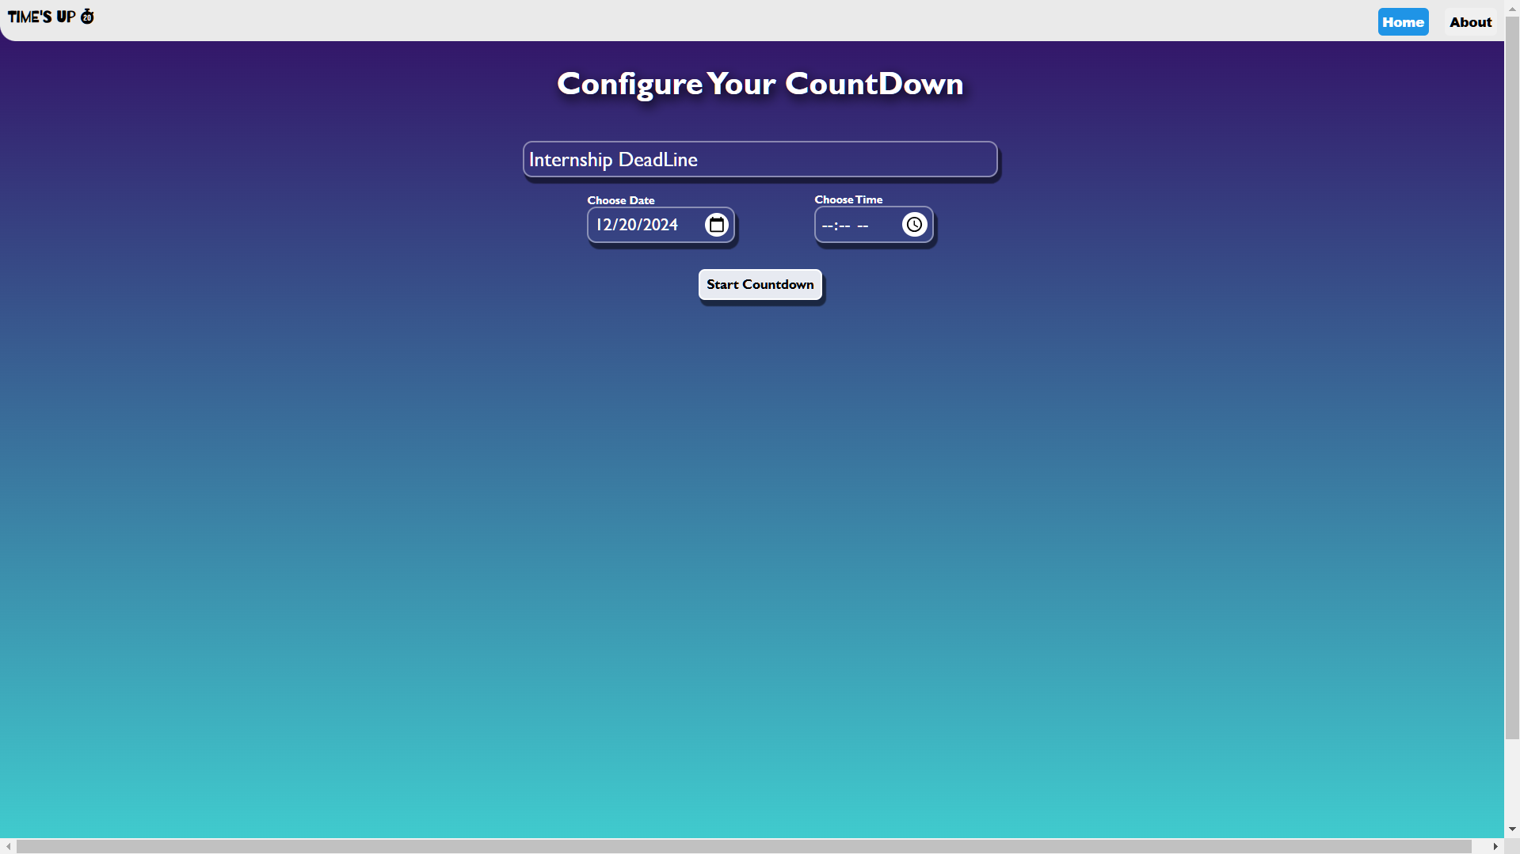
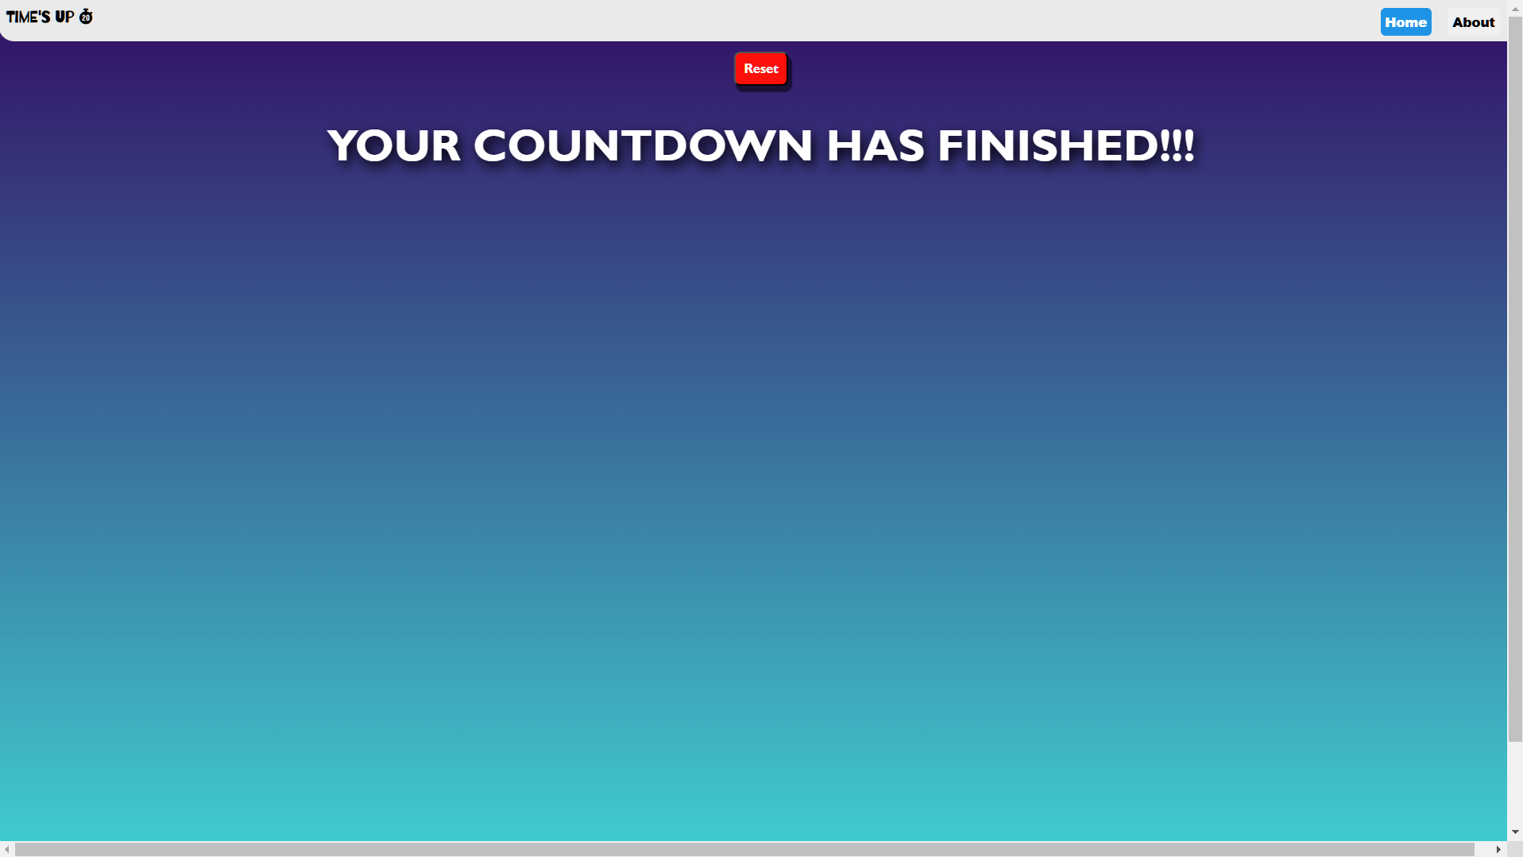
Output or Screenshots (PC)

Slide 9
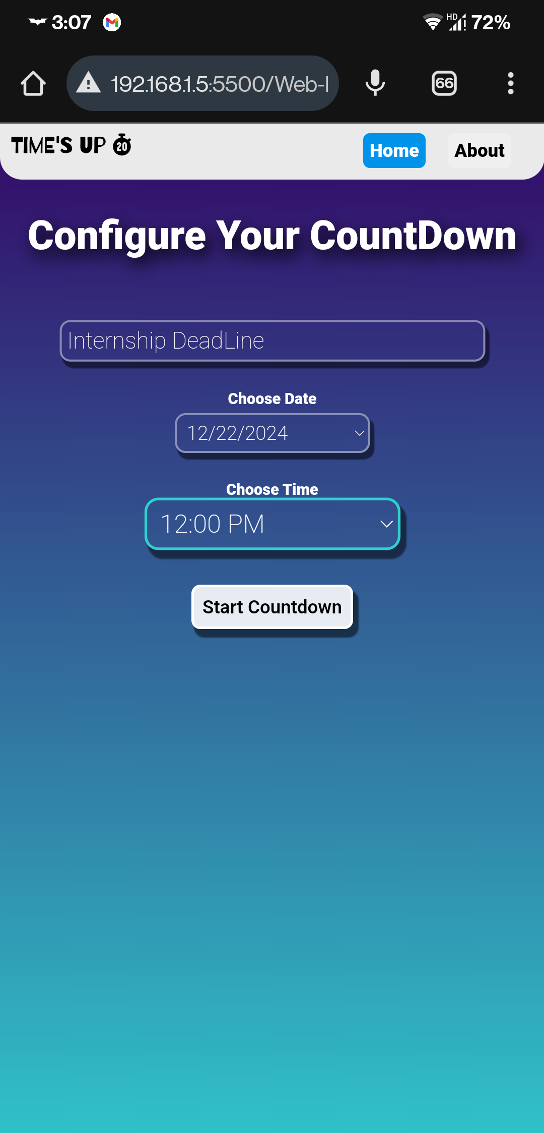

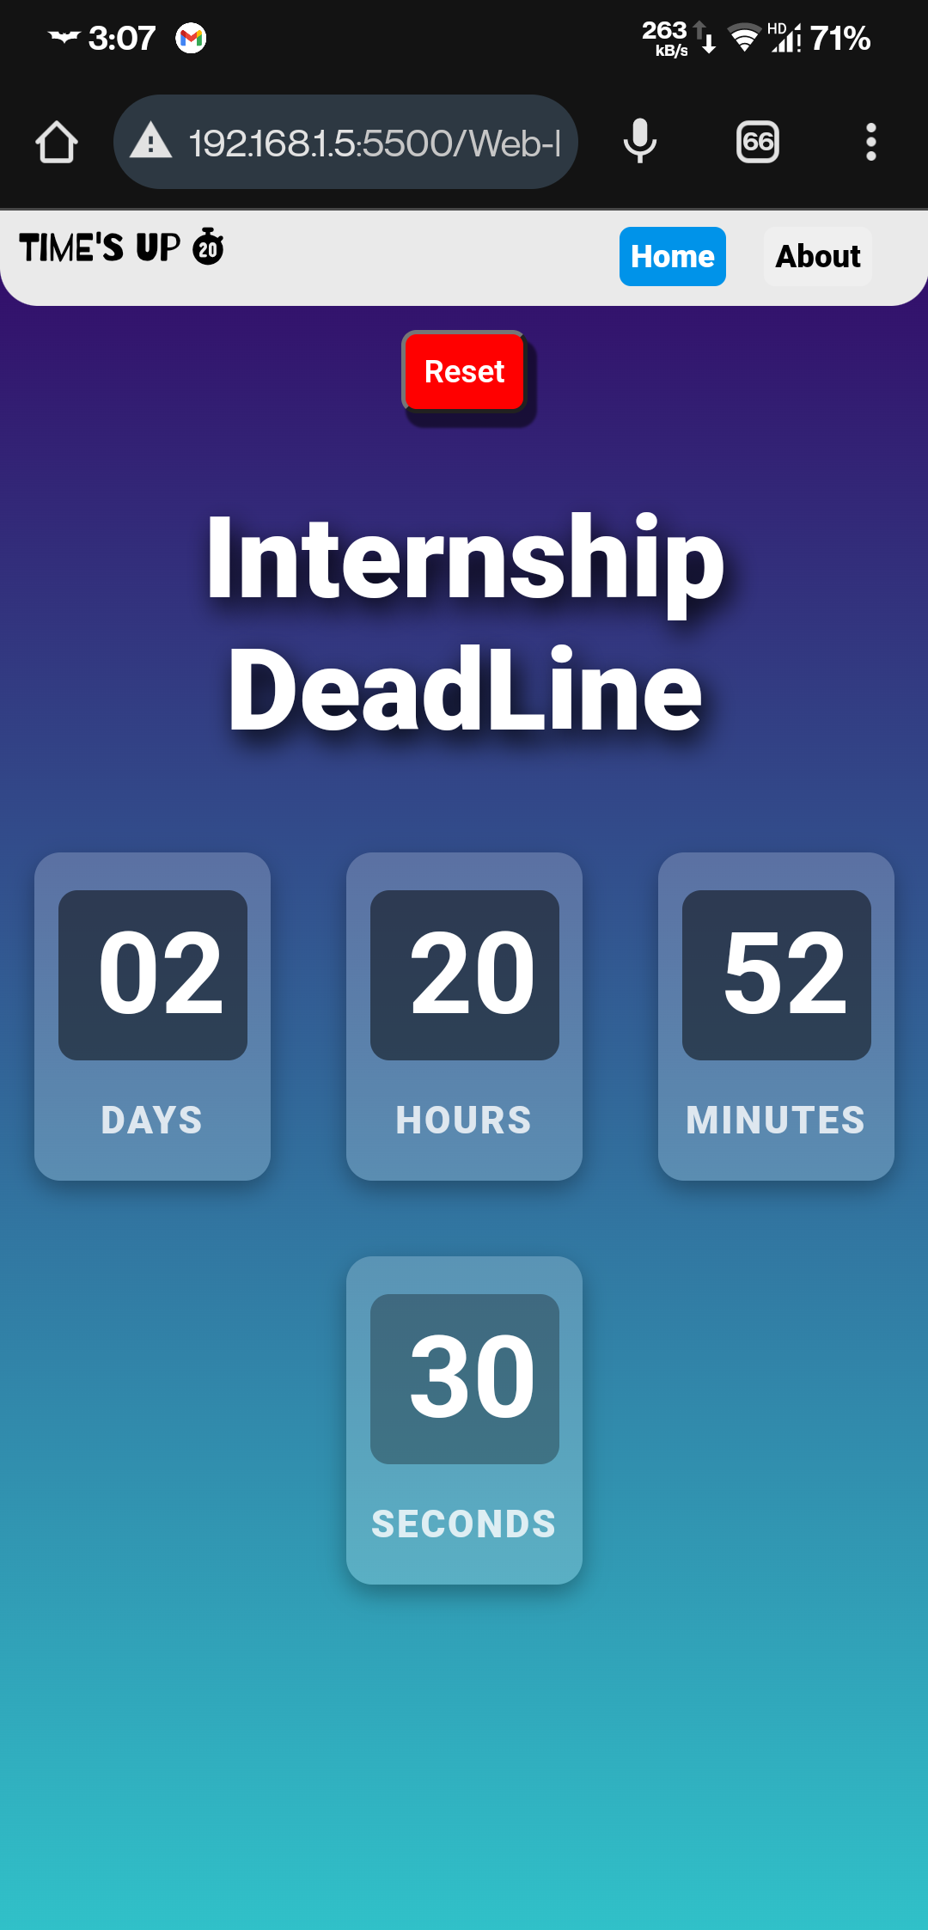
Output or Screenshots (Mobile)

Slide 10
KEY lEARNINGS
1. Event Handling
2. DOM Manipulation
3. Date and Time Calculation
4. Conditional Logic
5. Timers with `setInterval`
6. State Management
7. Error Handling
8. UI/UX Design

Slide 11
Project 2: Interactive Quiz app

Slide 12
Objectives
User-Friendly Interface: Create an intuitive design for easy navigation through the quiz.
Randomized Questions: Display random questions from a predefined list for a unique quiz experience.
Hints & Visual Aid: Provide helpful hints and images for each question.
Progress Tracking: Show the current question number and track the user’s progress.
Score Calculation: Calculate and display the final score at the end of the quiz.
Reset Functionality: Allow users to restart the quiz at any time.
Responsive Design: Ensure the app works seamlessly across devices.
Engagement: Create an interactive and engaging experience for users.

Slide 13
Problem statement
Develop an interactive quiz app with random question selection.
Display multiple answer choices and provide hints for each question.
Track user progress through the quiz.
Calculate and display the final score at the end of the quiz.
Allow users to reset the quiz and restart from the beginning.
Ensure smooth user interaction and navigation.
Implement a responsive design for seamless use on all devices.

Slide 14
Features
Random question selection from a list.
Multiple answer options for each question.
Hints to help users answer.(if available)
Track the current question number.
End the quiz with score summary

Slide 15
Techniques Used to solve
React:
For building the interactive UI and managing component states.
useState:
For managing states such as question, options, and count.
useEffect:
For updating references when the state changes.
useRef:
For preserving the current question count across renders.

Slide 16
Techniques Used to solve
Randomized Question Selection
Randomly select a question from a list of predefined questions (quizList.js).
Use Math.random() to choose a random index for the questions array.
Display the question and corresponding answer options.
State Management:
Used useState to update the displayed question, options, and hints dynamically.

Slide 17
Challenges Solved
Randomized question selection for a dynamic experience.
Managed quiz progress with React state (useState, useRef).
Displayed user progress (question number, score).
Ensured responsive design for all screen sizes.
Streamlined transitions between quiz stages.
Simplified user interaction for selecting answers.

Slide 18
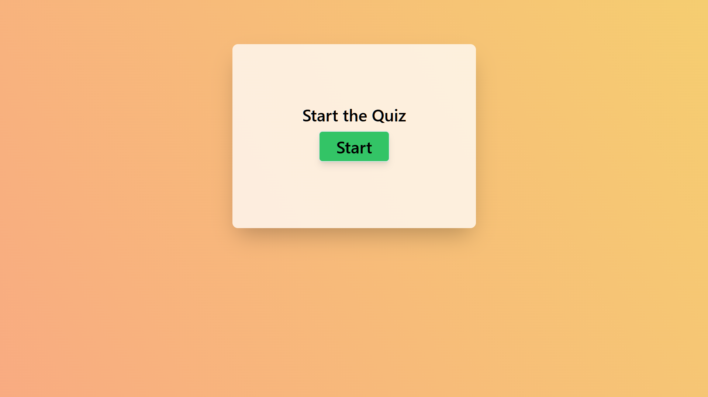
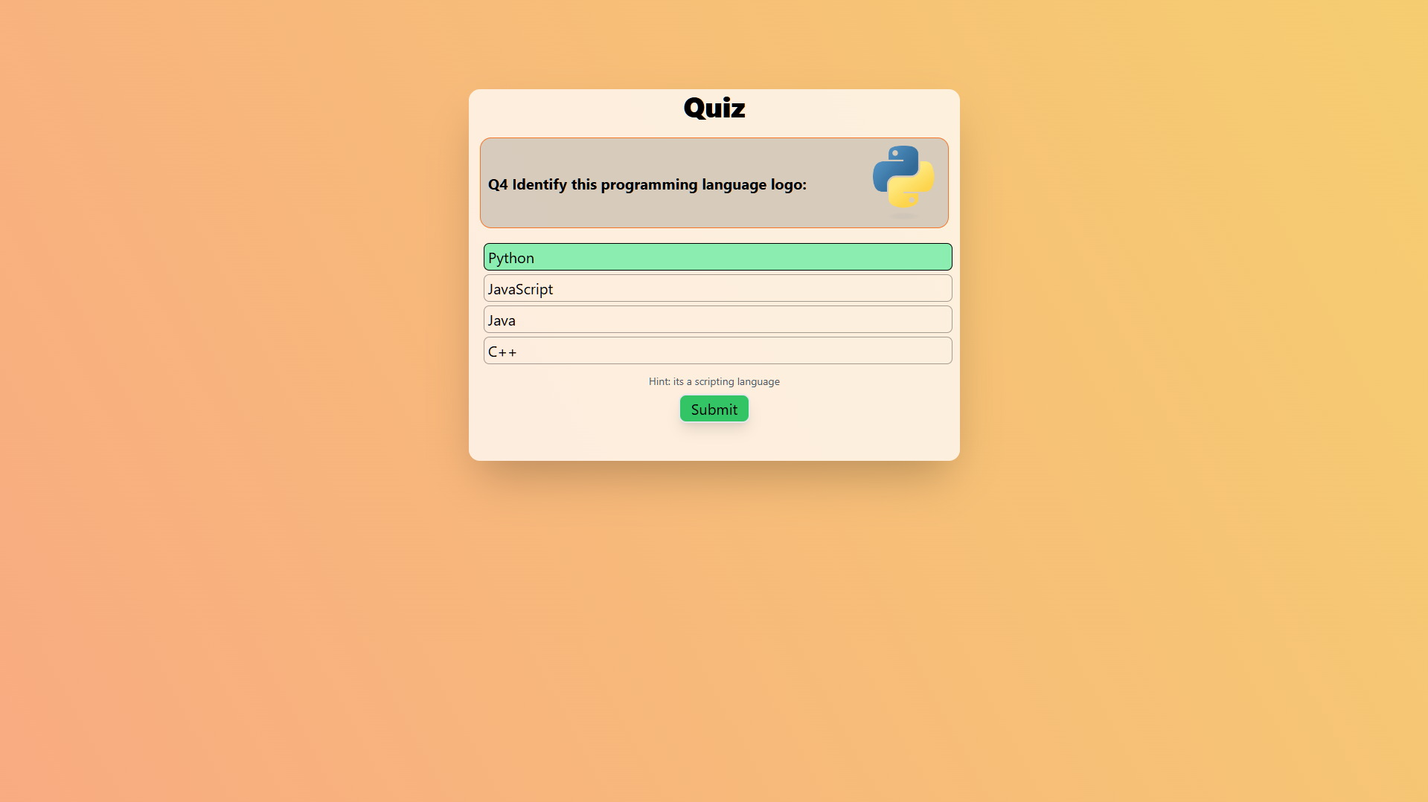
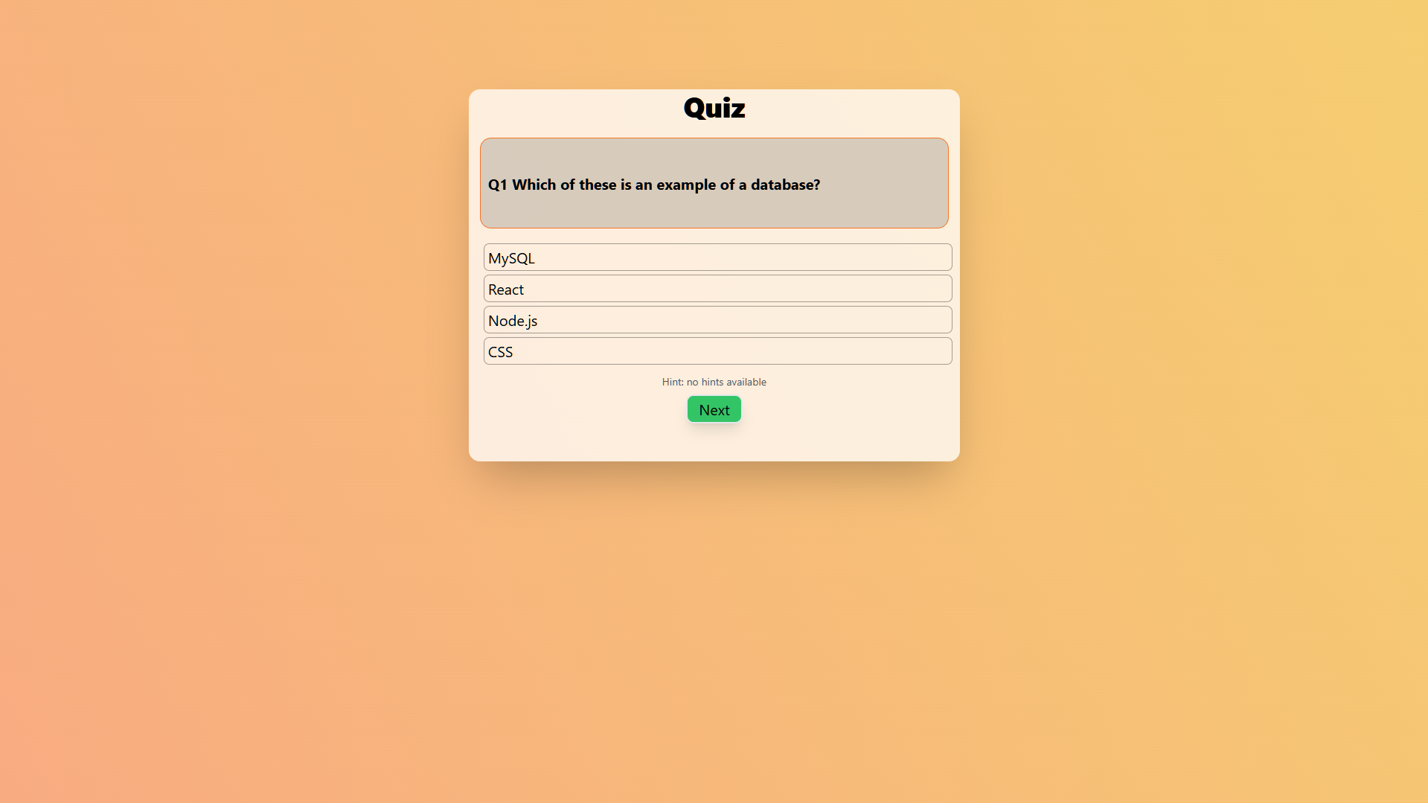
Output or Screenshots (PC)

Slide 19
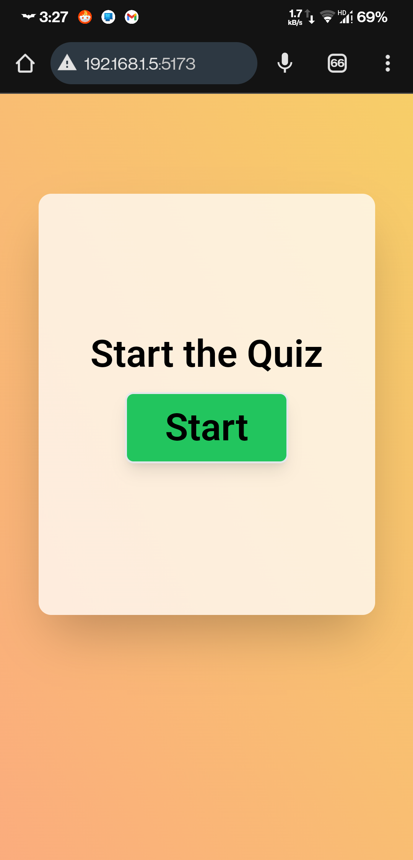
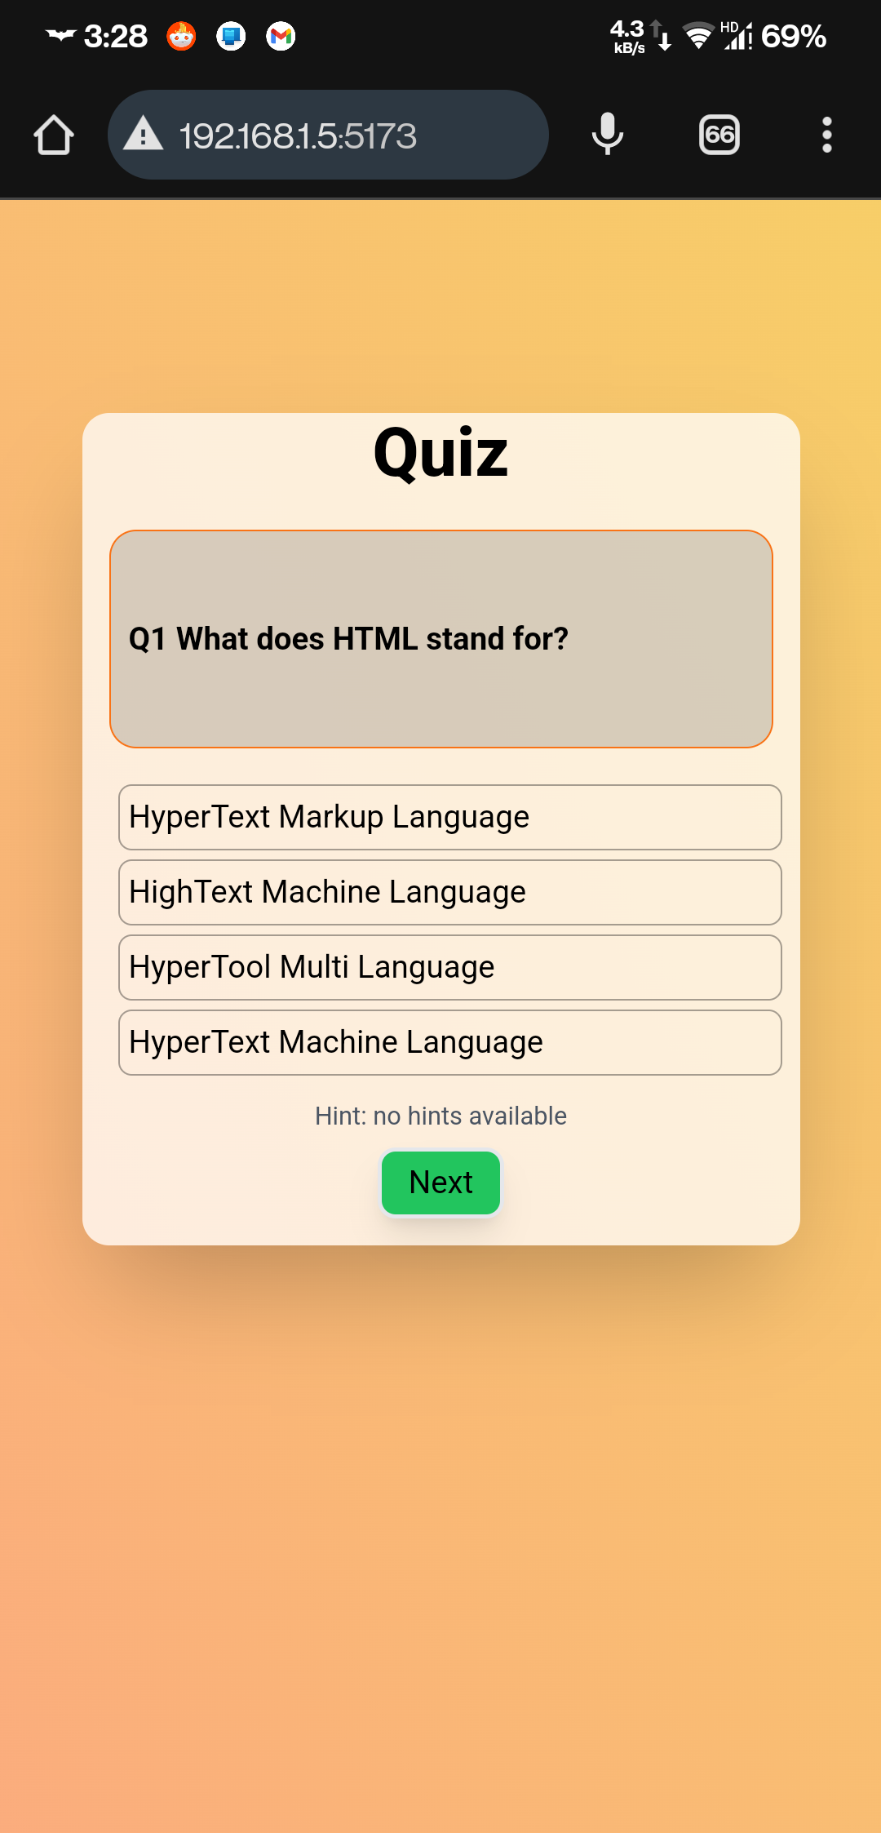
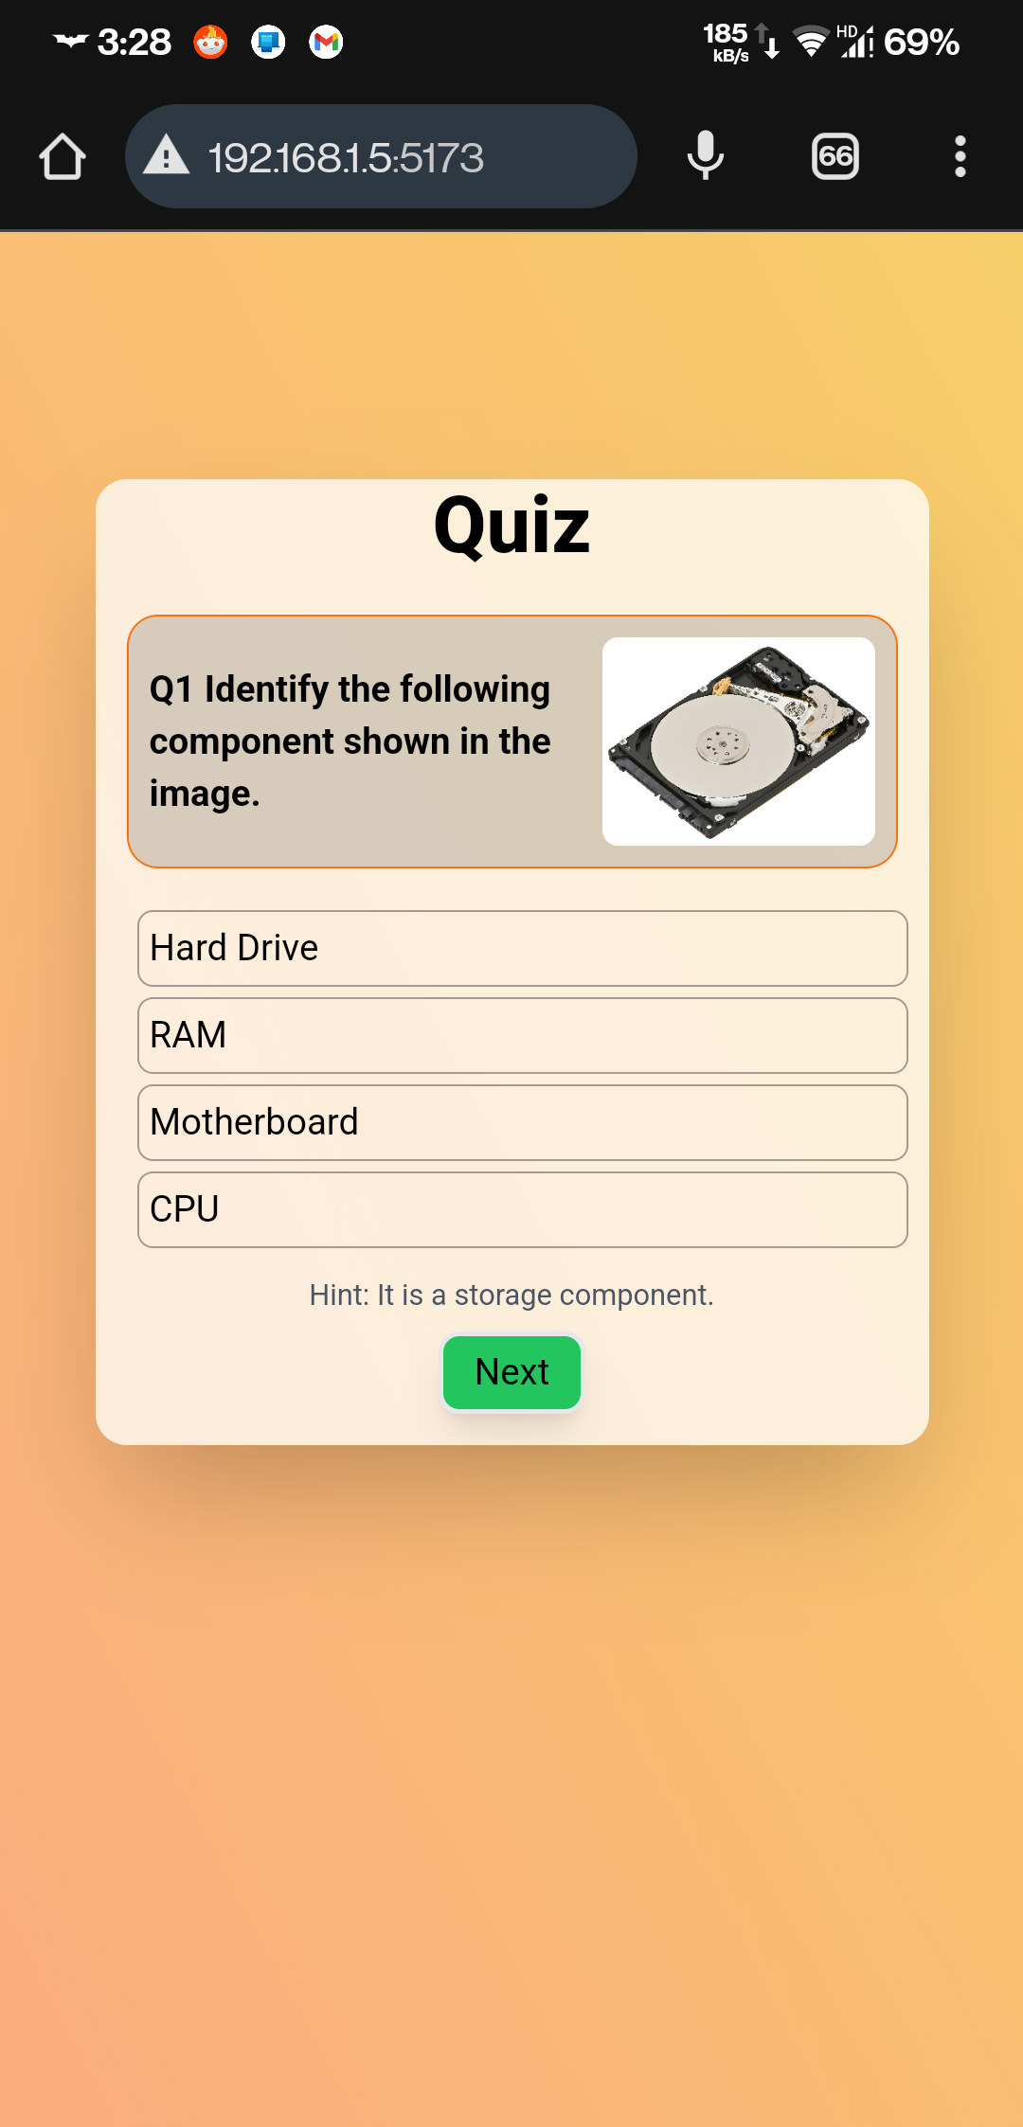
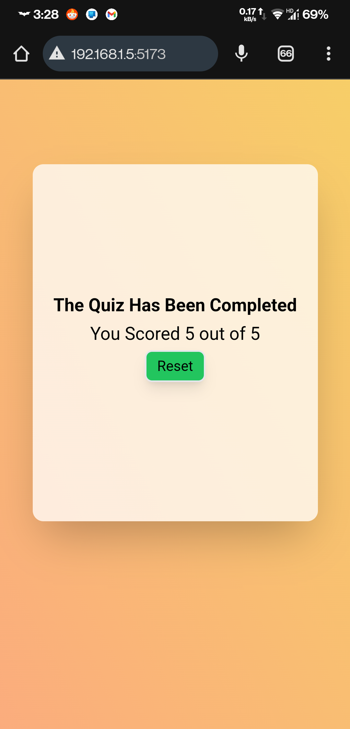
Output or Screenshots (Mobile)

Slide 20
KEY lEARNINGS
Improved understanding of React state management (useState, useRef).
Learned how to implement randomization in React.
Gained experience in handling dynamic user interfaces.
Enhanced skills in managing component visibility and transitions.
Applied responsive design techniques for various screen sizes.
Enhanced my knowledge of handling user interactions and feedback in a quiz app.

Slide 21
Thank you!
Contact:
Email: arshitkumar222@gmail.com
LinkedIn: https://www.linkedin.com/in/arshitkk
GitHub: https://github.com/arshitkk

